Slide 1
The Battle of Neighborhoods
Capstone Project

Slide 2
Table of contents
Business Problem
Data description
Analysis
Results and further steps

Slide 3
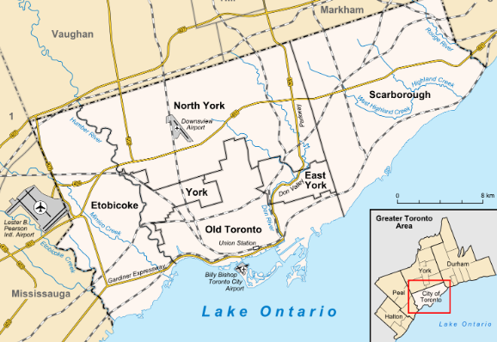
Business Problem
Toronto
- population of 2,731,571 in 2016
- fastest growing city in North America
- As a result: big competition between businesses especially restaurants
The main idea of this project is to suggest the best locality for your new restaurant in that highly demanded city

Slide 4
Data description
Based on definition of our problem, factors that will influence our decision are:
Already existing restaurants in the neighborhood (any type of restaurant)
Location of neighborhoods in the city center
Following data sources are used to get the required information:
Amount of restaurants and their types will be obtained by using Foursqare API: (https://foursquare.com/explore?mode=url&ne=44.418088%2C-78.362732&q=Restaurant&sw=42.742978%2C-80.554504)
Location of neighborhoods in the city center will be generated algorithmically using a list of postal codes of Toronto provided by Wikipedia: https://en.wikipedia.org/wiki/List_of_postal_codes_of_Canada:_M

Slide 5
Analysis
Data capturing and preprocessing Capture and clean all the relevant data
Exploring, clustering and visualizing neighborhoods in Toronto Explore the neighborhoods in the city of Toronto, get available Top venues including restaurants and visualize these on a map
Examining Clusters Explore each cluster and determine the discriminating venue categories that distinguish each cluster. Finally, I identify the clusters with maximum number restaurants and vice versa clusters which would be suitable for a new restaurant.

Slide 6
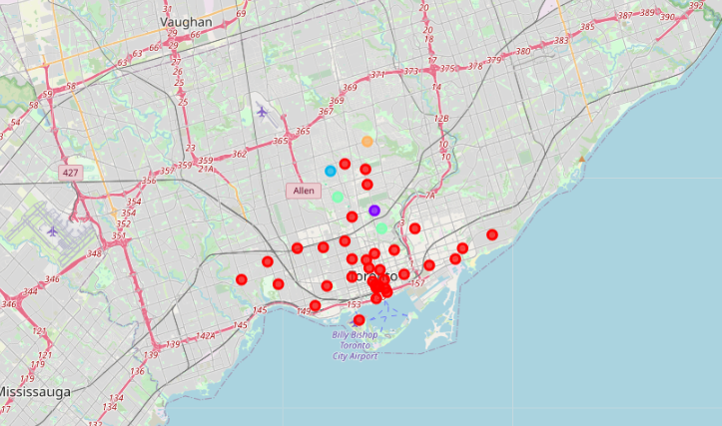
Results and further steps
Based on the resultant clusters it looks like Clusters 1 has a higher number of restaurants than the rest of the clusters. So these remaining clusters offer the highest potential for a new restaurant.
Final decission on optimal restaurant location will be made by stakeholders based on specific characteristics of neighborhoods and locations in every recommended zone, taking into consideration additional factors like attractiveness of each location, levels of noise such as proximity to major roads, real estate availability, prices, social and economic dynamics of every neighborhood and so on.

